Slide 1

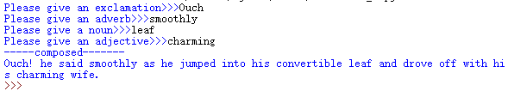
Mad libs – word game
Ask the user for some different words, and then compose into a sentence, or a short story. Make one program and try it by yourself.

Slide 2
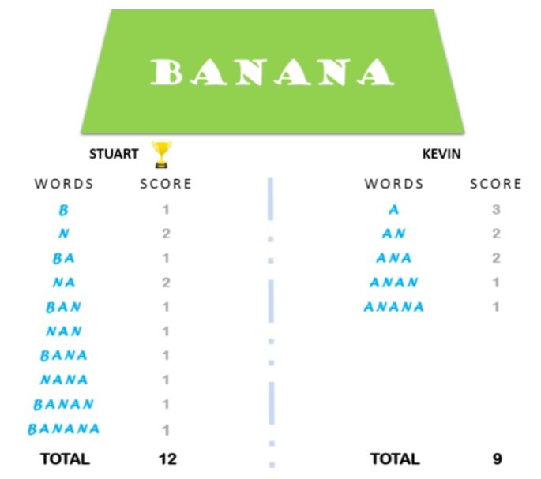
Minion string game
Give a string to 2 player, name them Kevin and Stuart. The string only contains alphabetic letters, no special character or digits. All string must be upper case letters.
Kevin will look for substring start with vowels (‘AEIOU’ are 5 vowels).
Stuart will look for substring start with non-vowels.
See how much they can find. The person who get more substrings win.
Example is for string “BANANA”

Slide 3
Palindrome word
Make a program, which can check if a word is palindrome or not.
Palindrome words, are those words that read from reverse order is same from beginning, like: madam, refer, racecar, etc.

Slide 4
Define your own function
Define a function countBs(), which accepts a string as argument, and return how many ‘B’ in this string.
Define a new function countChars(), which accepts one more argument, this second argument is a one letter string, specify which character want to count. And the function will return how many this character in the string.
Try to use the second function, to make a new countBs function.

